Slide 1
Concurrent programming
By Petar Georgiev

Slide 2
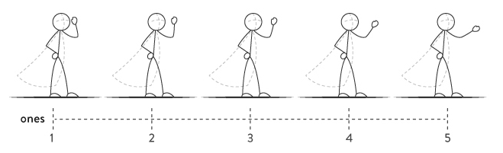
How does animation work?
Animation works by using an optical illusion
By presenting a sequence of still images in quick enough succession, the viewer interprets them as a continuous moving image;
At least 24 frames per second (why?)

Slide 3
How do programs run in an OS?
The OS gives the user the “sense” that programs run continuously
In reality, programs’ code runs for a small period of time (nanoseconds)
Switching between processes happens very fast
So the OS creates an illusion of continuously running processes

Slide 4
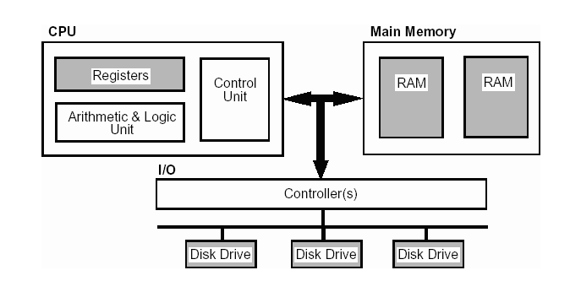
Components of a computer system CpU, memory, i/o

Slide 5
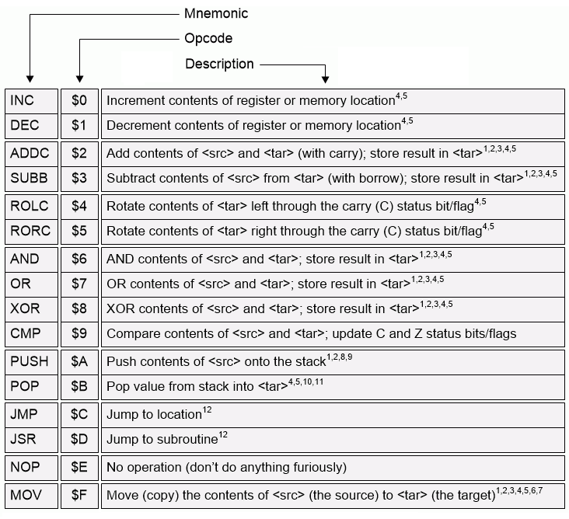
The Central Processing Unit (CPU)
The CPU executes instructions
Usually our program code is compiled (+linked) to a bunch of instructions that the CPU can “understand”
Each instruction tells the CPU to perform operations (like addition, subtraction, moving numbers between CPU and a location in memory etc.)
The group of instructions that a CPU supports is called an instruction set

Slide 6
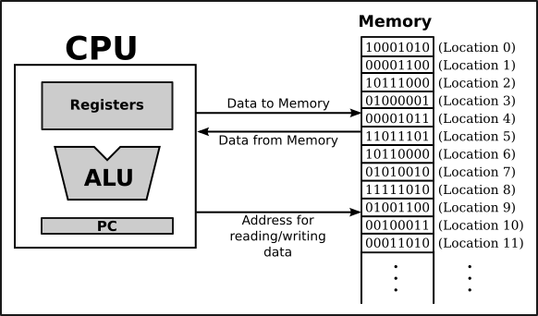
The Central Processing Unit (CPU)
The CPU reads or writes data from / to memory locations
The CPU controls which address is about to be accessed for reading / writing
The data is fetched or written at that particular address (depending of program’s code)

Slide 7
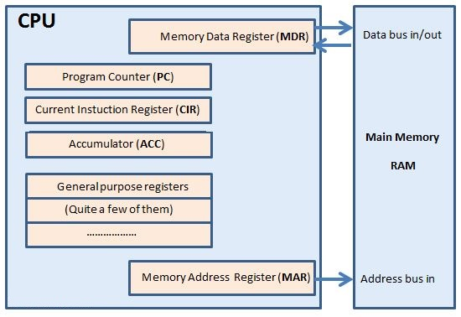
CPU registers
A register is a temporary storage area, built into a CPU
They are used by the CPU for performing calculations, comparisons etc.
Types:
Data registers
Address registers
General-purpose registers
Status registers
Floating-point registers
Special-purpose registers
Many more…

Slide 8
CPU registers
A register is a temporary storage area, built into a CPU
Examples for CPU registers:
Accumulator (ACC)
Program counter (PC)
Current Instruction Register (CIR)
Stack Pointer (SP)
General purpose registers (GP)
Many more…

Slide 9
What is a program?
A computer program is a collection of instructions that can be executed by a computer to perform a specific task.
A program is code + data.
Code:
The part of our program that performs actions / calculations
Functions, methods etc.
Data:
The strings, numbers and other constants in our code
Literals etc.

Slide 10
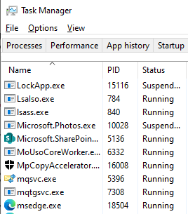
What is a process?
A process is a running instance of a program.
A typical “life” of a process:
The program is loaded into memory
The program is then executed by the CPU
At later point the program terminates

Slide 11
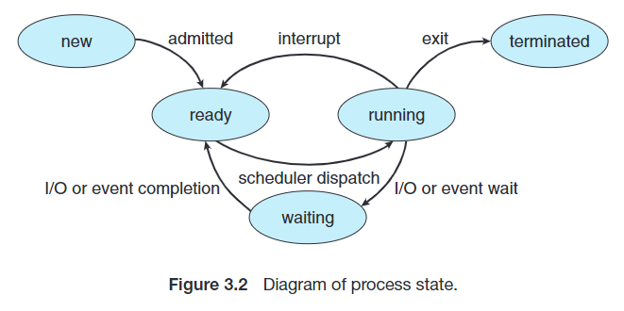
What is a process? States
Processes have different states (depends on the OS)
A process always exists in exactly one process state
During its lifetime, the process can switch (cycle) between some of the states
The new and terminated states happen only once

Slide 12
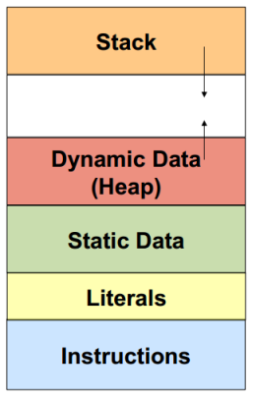
What is a process? A memory layout of a running process
Every process has a dedicated memory
A typical memory layout of a process is:
Stack (for local variables)
On Windows stack size if 1MB
Heap (dynamic memory).
Much bigger than the stack!
Place for static data
Place for literals (constants in our code)
Place for instructions (the code that performs actions)

Slide 13
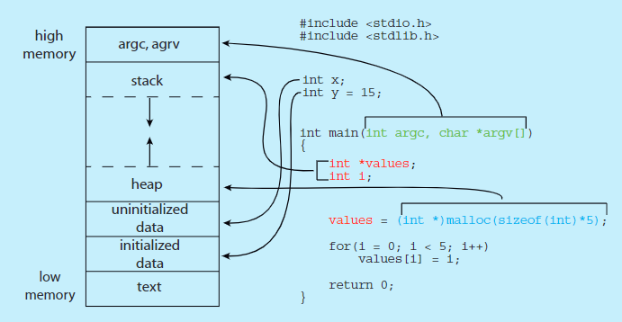
What is a process? A memory layout of a running process
Bytes in computer's memory are accessible via a unique address
"Low memory" means lower memory addresses
"High memory" means higher memory addresses

Slide 14
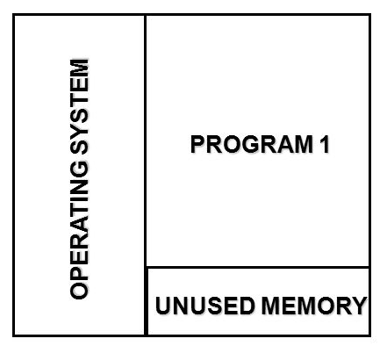
Single-tasking Еднопрограмност
Only one program is loaded into the memory
Load the program (into memory)
Execute the program
Exit the program (unload from memory)
E.g. only one program is executed at a given time
Examples:
DOS – Disk Operating Systems
Apple II, Pravetz 8 etc.

Slide 15
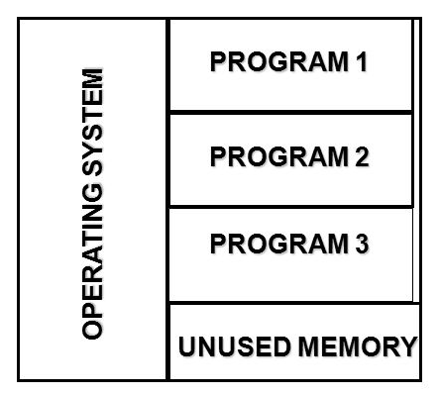
Multiprogramming многопрограмност
Multiple programs are loaded into the memory.
Multiple programs run „simultaneously“ on one CPU.
Workflow:
The first program is started.
If the program need to wait on I/O, the execution is transferred to the next process.
Multiprogramming is an older form of multitasking.

Slide 16
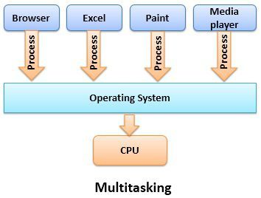
Multitasking многозадачност
Multitasking is a logical extension of multiprogramming.
Multitasking is a process of executing multiple tasks simultaneously.
It’s about time-sharing
We use multitasking to utilize the CPU.
Every process has a context (internal state)
The CPU saves the current context (state), loads the context of the next process and executes it.
This is called context switching

Slide 17
Multitasking (многозадачност) Types of multitasking
There are two types of multitasking (via time-sharing):
Cooperative (non-preemptive) multitasking (кооперативна многозадачност)
the OS never initiates a context switch from a running process to another process
processes voluntarily yield control periodically
Watchdog timer – to resolve potential system hang
Preemptive multitasking (изпреварващата многозадачност)
Preemption is the act of temporarily interrupting an executing task
Every process is allowed to run during a time slice (quantum) - ns
The time slice can vary depending on the OS
The time slice can be dynamic
Requires a scheduler (планировчик на задачите)
Processes / threads have priority

Slide 18
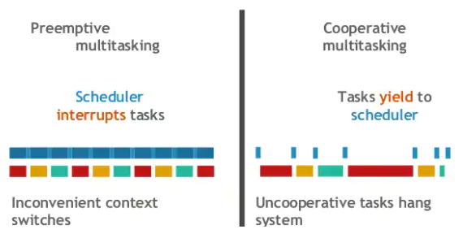
Multitasking (многозадачност)

Slide 19
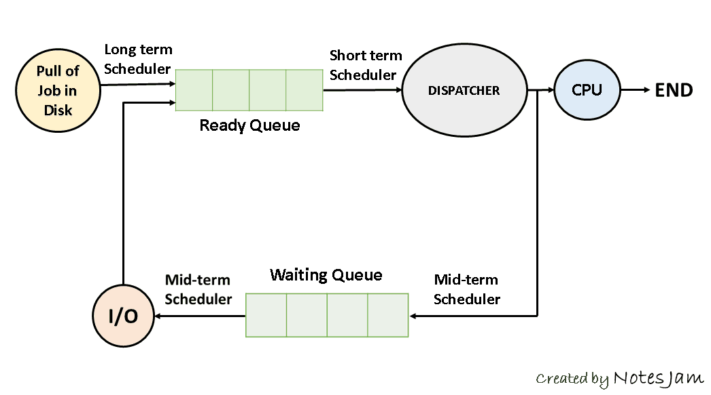
Multitasking (многозадачност) Scheduling (назначаване)
Scheduling is the action of assigning resources to perform tasks
The resources may be processors, network links or expansion card
The tasks may be threads, processes or data flows
The scheduling activity is carried out by a process called scheduler
Long-term scheduling
Medium-term scheduling
Short-term scheduling
Dispatcher

Slide 20
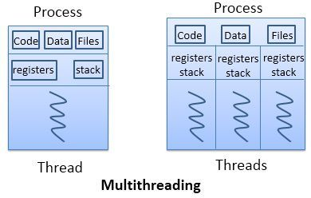
Multitasking (многозадачност) How to achieve multitasking
Multitasking can be achieved in two ways:
Process-based Multitasking (Multiprocessing);
Thread-based Multitasking (Multithreading) – used in modern operating systems.

Slide 21
Process-based Multitasking (Multiprocessing / многопроцесна многозадачност)
Each process has own memory
It is protected from other processes
Crashes in the current program do not affect other programs
Does not have access to other processes’ memory
A process is heavyweight.
Cost of communication between processes is high.
IPC – Inter Process Communication
Switching from one process to another requires some time for saving and loading registers, memory maps, updating lists, etc.

Slide 22
Thread-based Multitasking (Multithreading / многонишков / многопоточен)
Threads are lightweight processes
A threads belongs to a process (only one process)
Threads share the same address space
The address space of the process they belong
A thread is lightweight system object.
Cost of communication between threads is low.
Fibers
Even lighter unit of scheduling which are cooperatively scheduled

Slide 23
Multiprocessing
Multiprocessing is the use of two or more central processing units (CPUs).
I.e. running multiple processes on multiple CPUs.
There are two types of multiprocessing:
Symmetric Multiprocessing (SMP):
All CPUs are threated equally.
All CPUs share memory and have uniform access to memory.
Asymmetric Multiprocessing (AMP):
All CPUs are NOT threated equally
One CPU can run the OS
One CPU can handle I/O

Slide 24
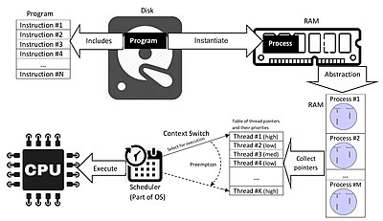
Processes
A process is the instance of a computer program that is being executed
Each process has an ID (PID)

Slide 25
Processes
In general, a process consists of:
An image of the executable machine code
Memory
Operating system descriptors of resources that are allocated to the process
Security attributes
Processor state (context)
if the OS supports threads it holds info about threads’ state
Other metadata
The operating system holds most of this information about active processes in data structures called process control blocks (PCBs)
The operating system may also provide mechanisms for inter-process communication (IPC)

Slide 26
Threads
A thread is a single unit of execution
Threads share owning process’s memory
Each thread has own stack, registers and thread-local storage (TLS)
This is known as context
Can be seen as a little virtual CPU
Two types:
Kernel threads (live in the Kernel)
User threads (live in the userspace)

Slide 27
Threads
Every thread has an ID (TID)
Threads have priority
Each thread has own stack, registers and thread-local storage (TLS)
This is known as context
Two types:
Kernel threads (live in the Kernel)
User threads (live in the userspace)
111 rule:
One thread can do one thing at one particular moment

Slide 28
Threads
Every process can have one or more threads
When the program is loaded into memory, the OS creates the so called Main thread and schedules it for execution
The Main thread executes program’s entry method
int void main()
That’s why a program can have only one method, called main()

Slide 29
Context switching (Threads)
As we know each thread is allowed by the OS to execute for a certain time period
After this period ends, the thread is paused:
The stack, registers etc. (the so called context) are saved
The OS switches to another thread:
The stack and registers (the context) are restored
The thread is then resumed
This process is called context switching.
Can be viewed with the “Process Explorer” tool
Context switching is a costly process
Usually, the context switching is initiated by the OS’ Scheduler (планировчикът на задачи)

Slide 30
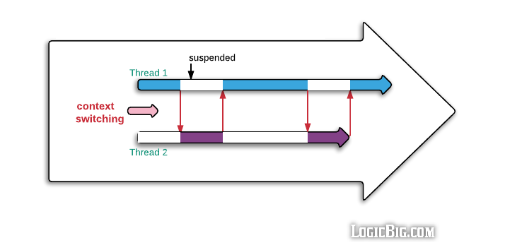
Context switching

Slide 31
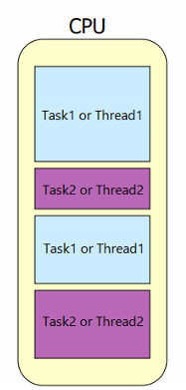
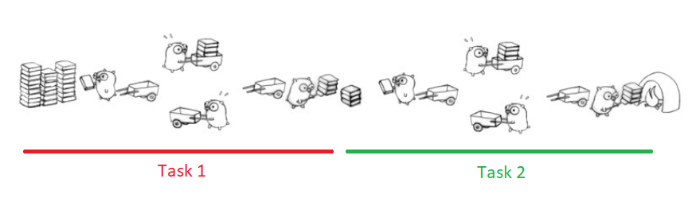
Concurrency
Concurrency is about dealing with a lot of things at the same time
Supporting two or more actions in progress at the same time
Examples:
Making a cake?
Gophers burning (C++) manuals ☺

Slide 32
Parallelism
Parallelism is about doing a lot of things at the same time.
Possible only on multicore / multiprocessor systems
Examples:
Jogging outside while listening a song
Students going to school in two or more schools
Talking on your mobile phone while cooking

Slide 33
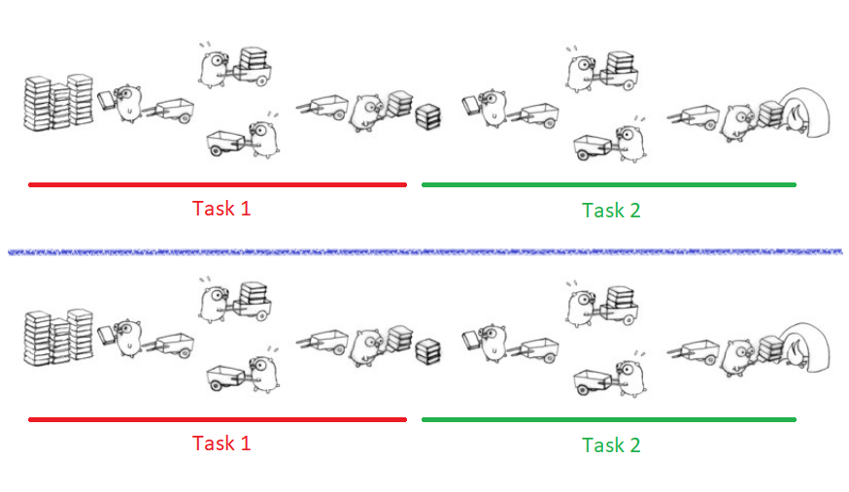
Parallelism

Slide 34
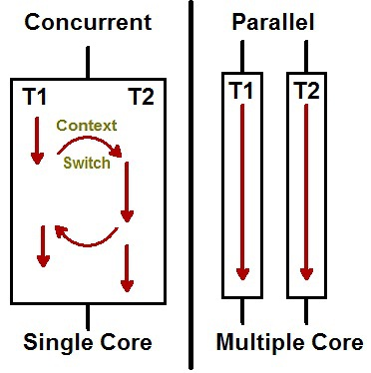
Parallelism

Slide 35
Concurrency vs. Parallelism

Slide 36
Synchronous and asynchronous
Different programming concepts
Sync and async are programming models

Slide 37
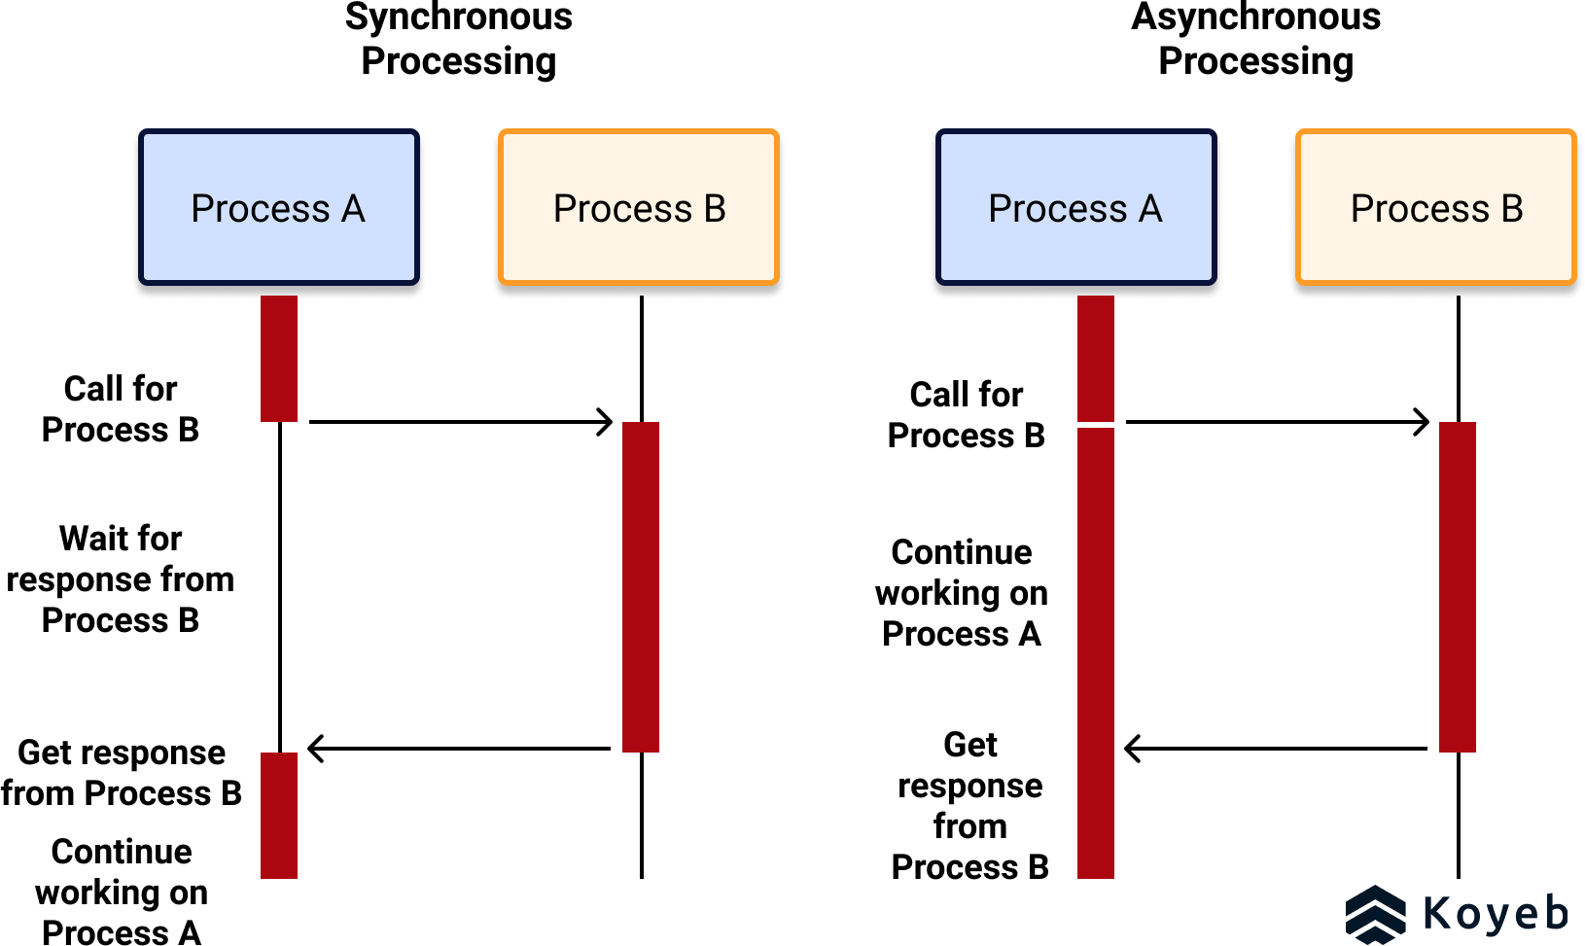
Synchronous and asynchronous

Slide 38
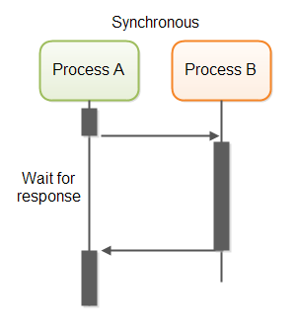
Synchronous execution

Slide 39
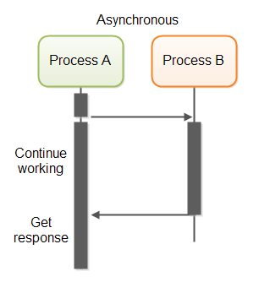
ASynchronous execution

Slide 40
Types of tasks
CPU-bound tasks (CPU intensive tasks)
when performing intensive calculations
always use some thread to execute their work
usually uses the entire time slice (quantum)
I/O-bound tasks
When the thread make use of external devices (HDD, USB, Network adapters etc.)
Writing file to a disk
Downloading file from the Internet
doesn’t use a thread until the I/O is finished
usually uses a part of the time slice (quantum)

Slide 41
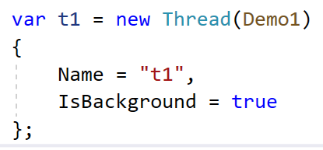
Multithreading in C#
Managed threads
Threads, managed by the CLR
Types of threads
Foreground threads
new Thread() creates a foreground thread by default
Background threads
Exceptions thrown within the threads?

Slide 42
Synchronization primitives in C#
Used to control access to a shared resource by multiple threads
They help to avoid race conditions
Represented by classes
Language and OS specific!
Laws
Must use try / finally or using() constructs
Waiting
Timeout

Slide 43
Synchronization primitives in C#
“A blocked thread is wasted thread”

Slide 44
Synchronization primitives in C#
The Monitor class
Grants mutually exclusive access to a shared resource
Serializes access to specific region of code
Only one thread at a time can execute the protected code
We can acquire or release a lock on a specific object
Avoid using this keyword! Create new lock object.
Avoid using literals! (boxing / unboxing issues)
The lock keyword
Synthetic sugar around Monitor + try / finally
Needs an instance of an object

Slide 45
Synchronization primitives in C#
The Mutex class (mutually exclusive / взаимно изключващ)
Provides exclusive access to a shared resource
Uses more system resources that the Monitor class
It can be used to synchronize threads in different processes
OS wide
Per session (visible to processes in the same session)
Global (visible to all processes)
Has security attributes
Ownership

Slide 46
Resources
https://vivadifferences.com/8-different-between-memory-and-registers/
https://pclt.sites.yale.edu/cpu-instructions
https://math.hws.edu/javanotes/c1/s1.html
https://github.com/AppleWin/AppleWin
https://archive.org/details/locksmith_v5.0
https://www.eeweb.com/building-a-4-bit-computer-the-instruction-set/
https://www.sciencedirect.com/topics/computer-science/multiprogramming
https://docs.microsoft.com/en-us/windows-hardware/drivers/kernel/multiprocessor-safe
http://techimind.blogspot.com/2016/12/multiprogramming-operating-system.html
https://en.wikipedia.org/wiki/Preemption_(computing)#PREEMPTIVE
https://en.wikipedia.org/wiki/Cooperative_multitasking

Slide 47
Resources
https://cfsamson.github.io/book-exploring-async-basics/1_concurrent_vs_parallel.html
https://medium.com/from-the-scratch/wtf-is-synchronous-and-asynchronous-1a75afd039df
https://github.com/AppleWin/AppleWin/releases
https://mirrors.apple2.org.za/ftp.apple.asimov.net/images/
http://pravec8.agatcomp.ru/obrazi_svalka.htm
https://www.koyeb.com/blog/introduction-to-synchronous-and-asynchronous-processing

